Slide 1
Manganese , gout, Ascites
Manganese (Mn) is the fifth most abundant mineral on earth , and it was first reported to prevent perosis in broilers by1936).
Mn deficiency in poultry is associated with structural and physiological disorders, which
include cartilage and skeletal malformation as well as a reduction in the antioxidant defense system
A dietary manganese deficiency in immature chickens and turkeys is one of the potential causes of perosis and chondrodystrophy
and also the production of thin-shelled eggs and poor hatchability in mature birds

Slide 2
Clinical signs
In young chicks, manganese deficiency causes slipped tendon or perosis, characterized by swelling and flattening of the hock joint, along with subsequent slipping of the Achilles tendon from the condyles. One or both of the chick's legs may be affected
thickening and shortening of the leg bones, and if severe, slippage of the gastrocnemius tendon from its condyles.
Increased intakes of calcium and/or phosphorus will aggravate the condition because of reduced absorption of manganese via the action of precipitated calcium phosphate in the intestinal tract

Slide 3
In laying hens, reduced egg production, markedly reduced hatchability, and eggshell thinning are often noted.
A manganese-deficient breeder diet can result in chondrodystrophy in chick embryos. This condition is characterized by shortened, thickened legs and shortened
Deformities cannot be corrected by feeding more manganese. Effects of manganese deficiency on egg production are fully corrected by feeding a diet that contains at least 30–40 mg of manganese/kg, provided the diet does not contain excess calcium and/or phosphorus..

Slide 4
Urate Deposition (Gout) in Poultry
Gout is caused by the precipitation of urates in the viscera (acute urate deposition) or the joints (chronic urate deposition).
The urate deposits on serous coats resemble a chalky white dust.
Acute and chronic urate deposition differ in etiology, morphology, and pathogenesis.
Acute urate deposition (ie, visceral gout) is the counterpart to uremia in mammals. Chronic urate deposition (ie, articular gout) is the equivalent of gout in mammals.

Slide 5
Birds excrete nitrogenous wastes as urates bound in colloidal form with mucus in their urine.
Renal dysfunction decreases the clearance of uric acid from the blood, which results in hyperuricemia with precipitation of insoluble products within the kidney itself or other organs, leading to urate deposition or urolithiasis

Slide 6
Visceral urate
deposition occurs after rapidly progressing renal failure
. Deposits develop most commonly on the pericardium, peritoneum, and liver capsule and rarely on synovial surfaces of joints and tendons

Slide 7
Visceral urate deposition may be secondary to urolithiasis, which is common in older laying chickens.
Progressive obstruction of the ureters by uroliths causes kidney atrophy “upstream” of the site of ureteral obstruction and compensatory hypertrophy by the undamaged portions of the kidney

Slide 8
Predisposing factors for visceral urate deposition and urolithiasis in poultry include infectious bronchitis virus, avian nephritis virus, and cryptosporidiosis.
Noninfectious causes include dehydration, ingestion of feed containing > 3% calcium by nonlaying chickens, vitamin A deficiency, and exposure to myotoxins (eg, oosporein).
Other avian species commonly develop visceral deposits secondary to nephrotoxin exposure, most commonly aminoglycoside antibiotics or heavy metals.

Slide 9
Articular urate deposition is less common and occurs after longterm increases in serum levels of uric acid.
Deposits develop on synovial membranes in the toes and wing joints and incite a chronic granulomatous reaction to urate crystals (tophi). Joints are enlarged, and the feet appear deformed. Unlike visceral urate deposition, the kidneys are usually grossly normal.
Articular urate deposition may be seen in birds that have hereditary defects in uric acid metabolism or that are fed excessive protein.

Slide 10
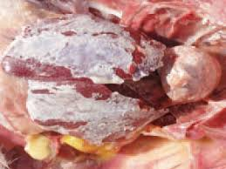
Visceral gout

Slide 11
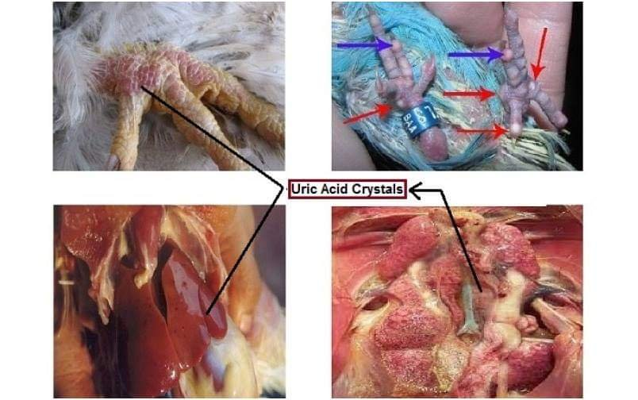

Slide 12
Ascites syndrome water belly pulmonary hypertension
Ascites syndrome in poultry refers to right heart failure, usually due to pulmonary hypertension. The syndrome is most often associated with high altitude, rapid growth rate, or cold stress as chicks.
Ascites is an accumulation of non inflammatory transudate in one or more of the peritoneal cavities or potential spaces. The fluid accumulates most frequently in the two ventral hepatic, peritoneal, or pericardial spaces and may contain yellow fibrin clots.
Although ascites can result from increased vascular hydrostatic pressure, vascular damage, increased tissue oncotic pressure, or decreased vascular oncotic (usually colloidal) pressure, in poultry it is most commonly associated with increased venous hydrostatic pressure.

Slide 13
Pulmonary hypertension occurs frequently in chickens secondary to high altitude–associated hypoxia, with resultant polycythemia and increased blood viscosity.
It also occurs frequently secondary to the RBC rigidity of sodium toxicosis and less frequently from lung pathology.
In poultry, liver damage may also be due to aflatoxin or to toxins from plants such as Crotalaria. In broiler chickens, obstructive cholangiohepatitis (due to Clostridium perfringensinfection) is the most common cause of the liver damage, which results in ascites.
In both meat-type ducks and breeders, amyloidosis of the liver may also cause ascites.

Slide 14
Pathogenesis and Epidemiology of Ascites
Ascites syndrome results from increased pressure in the pulmonary arteries when the heart tries to pump more blood through the lungs to meet the body’s oxygen requirement.
The resultant volume and pressure overload on the right ventricle lead to dilatation and hypertrophy of the right ventricular wall, valvular insufficiency, RVF, and ascites

Slide 15
Predisposing factors that increase oxygen demand (eg, cold), decrease oxygen-carrying capacity of the blood (eg, acidosis, carbon monoxide), increase blood volume (eg, sodium), or interfere with blood flow through the lung (eg, lung pathology that narrows or occludes capillaries, increased RBC rigidity, or polycythemia with increased blood viscosity) may result in flock outbreaks of ascites syndrome with or without ascites.
Sporadic individual cases of RVF and ascites without these predisposing factors can occur in fast-growing broilers.

Slide 16
Clinical signs
Sudden deaths in rapidly developing birds.
Poor development.
Progressive weakness and abdominal distension.
Recumbency.
Dyspnoea.
Possibly cyanosis

Slide 17
lesions
Post-mortem findings of ascites syndrome include variable amounts of clear, yellow fluid and clots of fibrin in the hepatoperitoneal spaces and pericardium, and a swollen liver.
Hydropericardium is mild to marked; occasionally there is pericarditis with adhesions, usually from secondary infections. The liver may be firm with irregular margins due to edema, have clotted protein adherent to the surface, may be nodular, shrunken or even white with subcapsular edema and a thickened capsule.

Slide 18
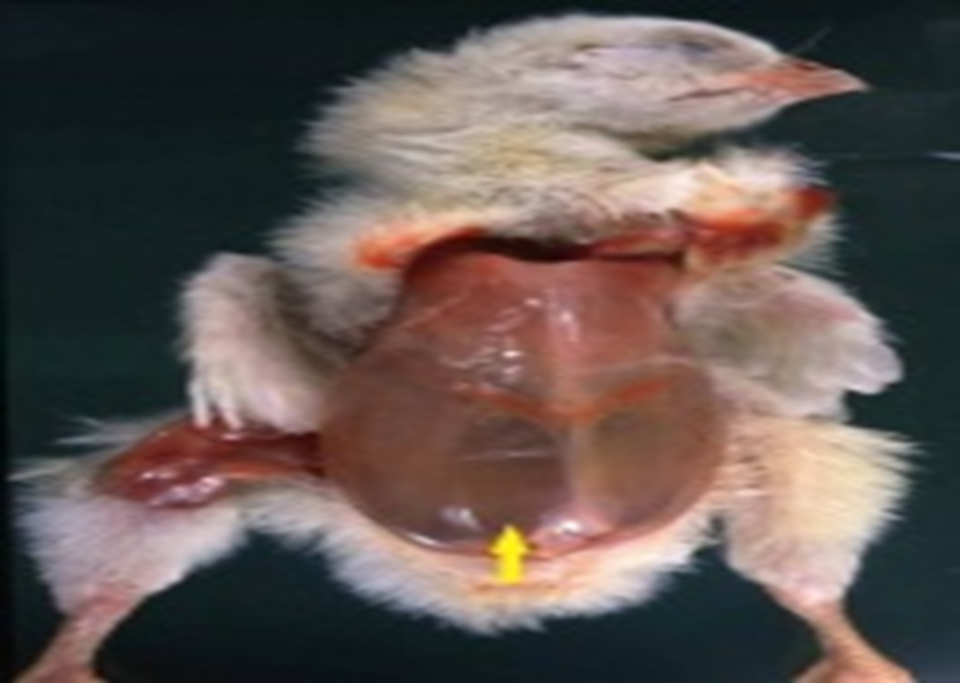

Slide 19
References
ByBilly M. Hargis, DVM, PhD, DACPV, Department of Poultry Science, Dale Bumpers College of Agricultural, Food and Life Sciences, University of Arkansas and the Arkansas Agricultural
Experiment Station, UA Division of Agriculture

